Slide 1
Tabulation of Data

Slide 2
Tabulation of Data
Tabular representation of Data known as tabulation
Definition:
Orderly or Systematic representation of numerical data in rows and columns designed to clarify the problem under consideration and to facilitate comparison between the figures

Slide 3
Tabulation of Data
Advantages
Tabulation simplifies collected data
Tabulation presents quantitative data in concise and condensed form
It facilitates comparison of data
Presentation of data in tabular form provides a basis for analysis and interpretation of data
Objectives
To simplify collected data
To present quantitative data in concise and condensed form

Slide 4
Different Parts of the Table
Table Number
Should be identified by number
Facilitates easy reference
Given at beginning of title of the table OR can be centered above the table
Title
Must be written either below the table OR after table number in same line
Should convey full description of table
Stub
Extreme left hand column of the table indicating headings of row

Slide 5
Different Parts of the Table
Caption
Heading of the column
Upper part of the table
Can be sub heads or sub captions in each caption
Body
Main part of the table containing numerical figures
Total
Total and sub totals of every row and column must be provided
Footnotes
Explanatory Note written beneath the table
Purpose is to clarify some of the specific terms
Source
Sources of data embodied from should be mentioned
If data is collected from secondary sources
Given below footnote

Slide 6
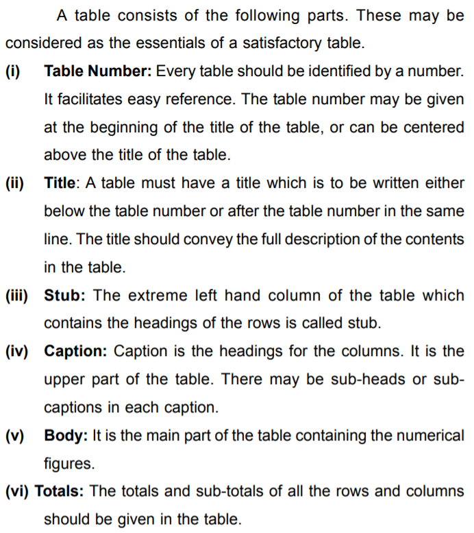

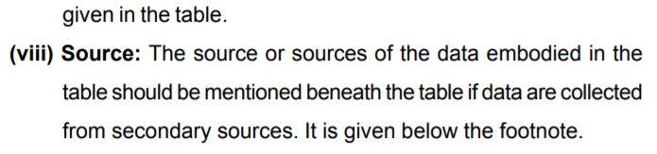
Different Parts of a Table

Slide 7
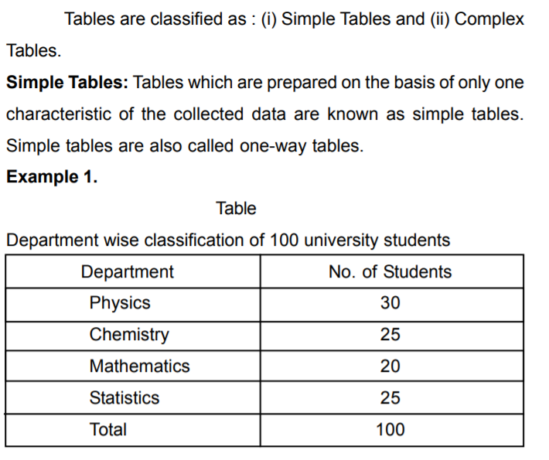
Types of Tables

Slide 8
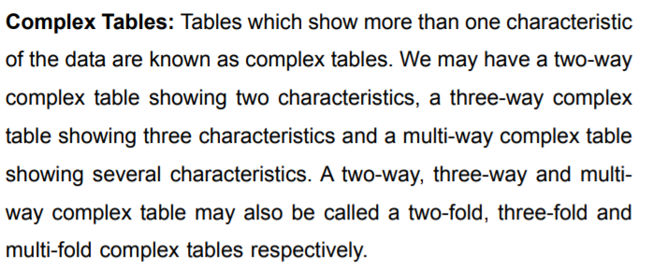
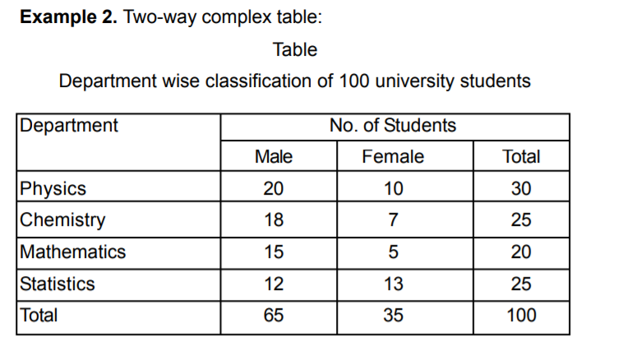
Types of Tables

Slide 9
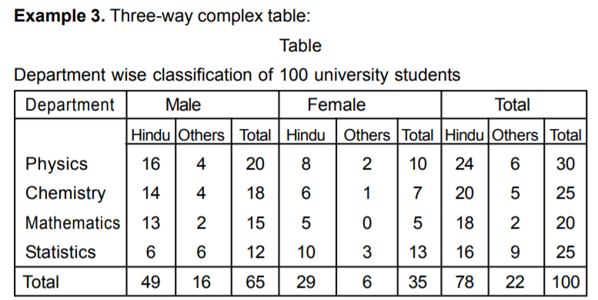
Types of Tables

Slide 10
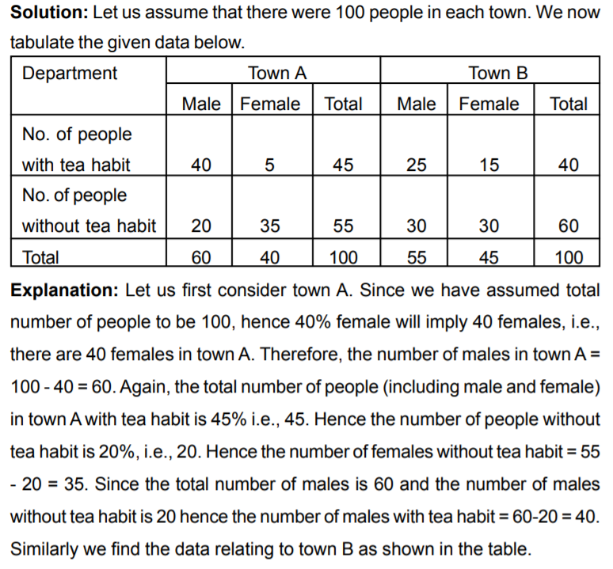
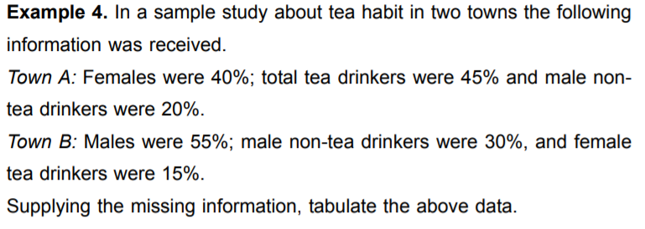
Types of Tables

Slide 11
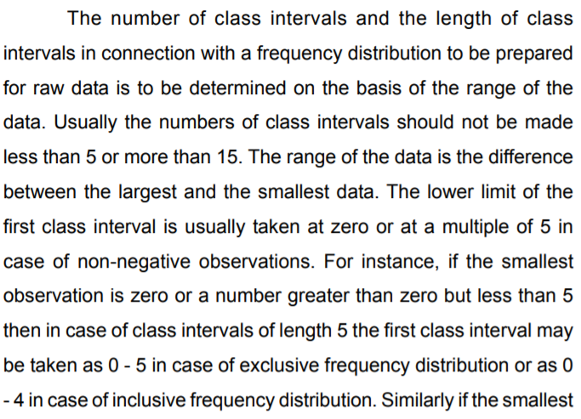
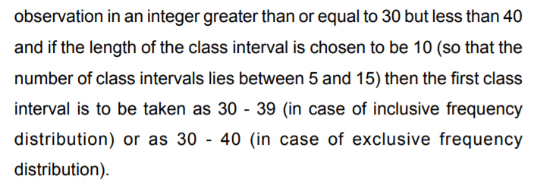
Calculation of Class Frequencies and Formation of Frequency Distribution Table

Slide 12
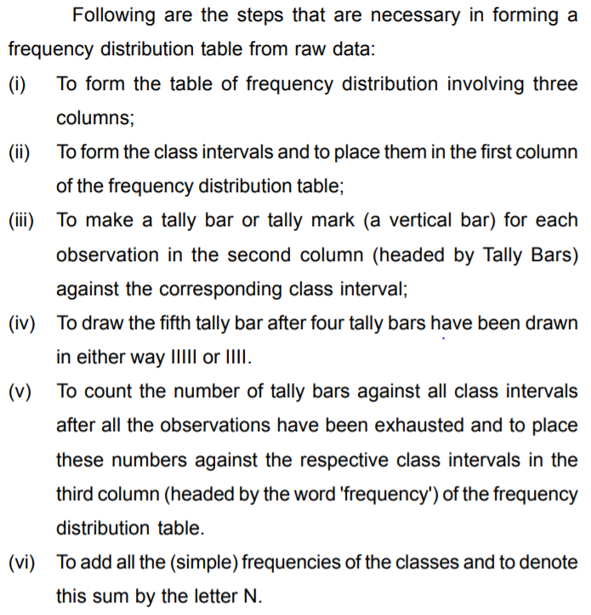

Slide 13
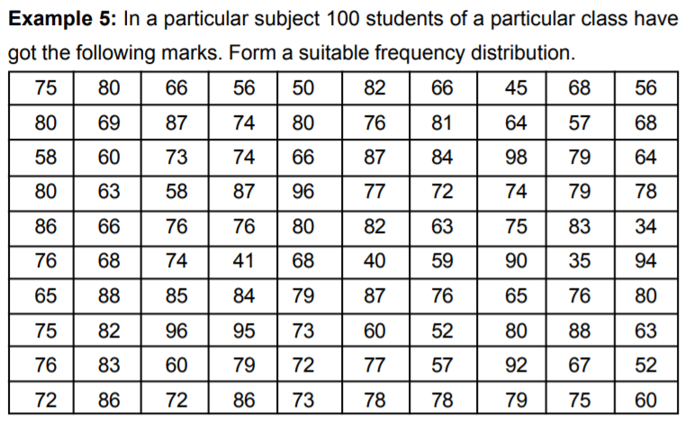

Slide 14
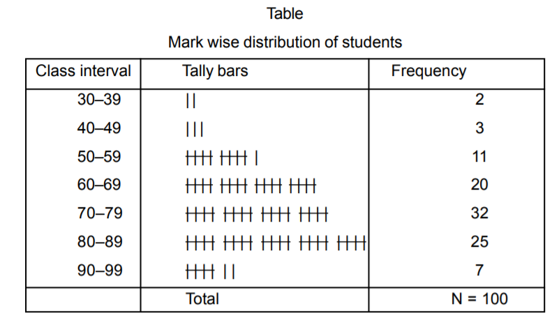

Slide 15
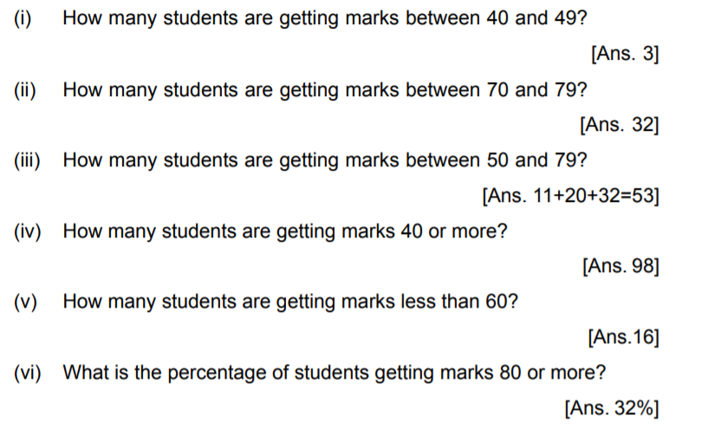


Slide 16
Statistical Data Representation

Slide 17
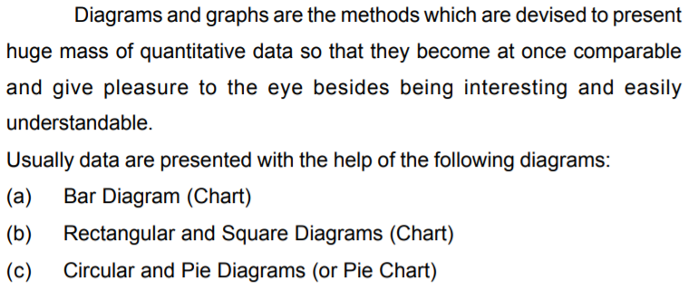
Methods of Statistical Data Representation

Slide 18
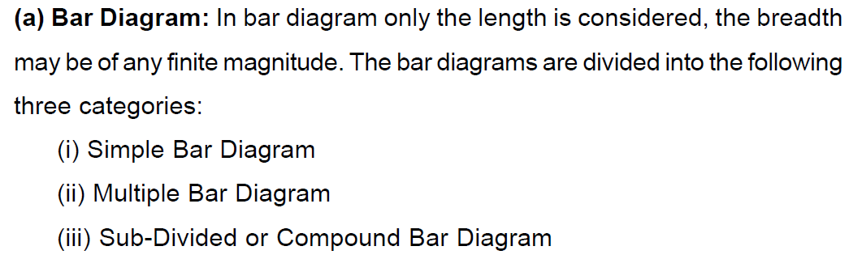
Bar Diagram

Slide 19
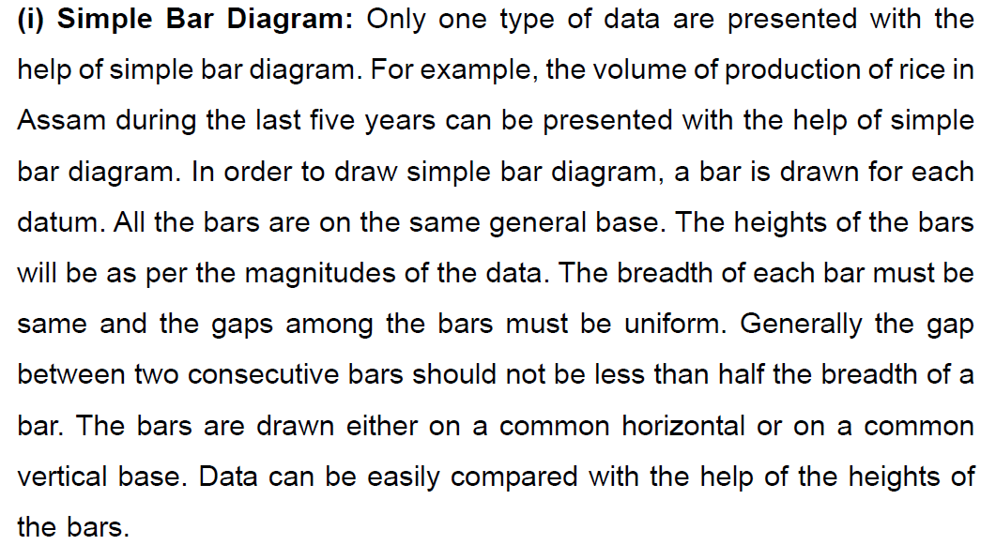
Bar Diagram

Slide 20
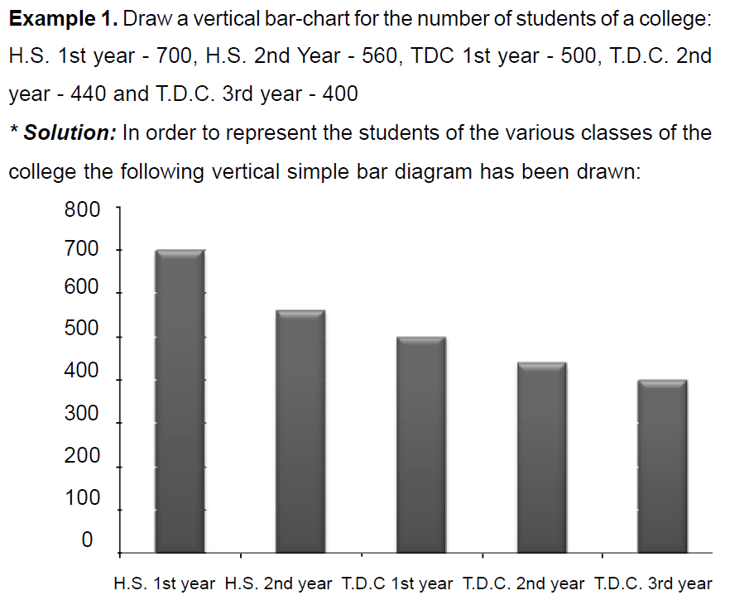
Bar Diagram

Slide 21
Bar Diagram
HS First Year 700
HS Second Year 560
TDC 1st Year 500
TDC 2nd Year 440
TDC Third Year 400

Slide 22
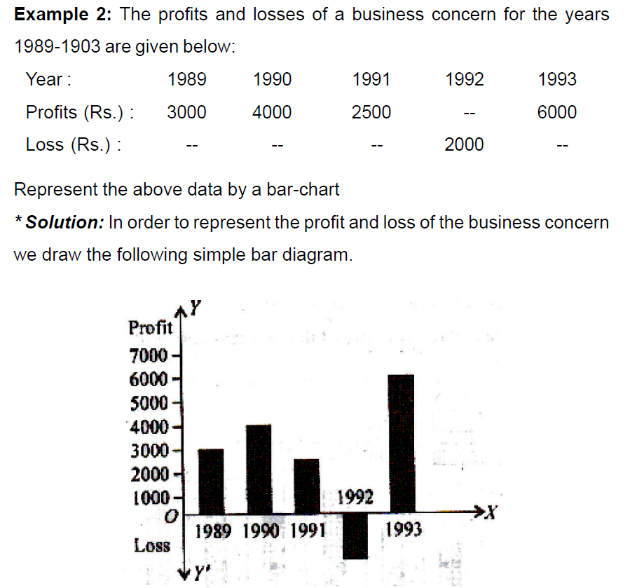
Bar Diagram

Slide 23
Bar Diagram
Year Profit
1989 3000
1990 4000
1991 2500
1992 -2000
1993 6000

Slide 24
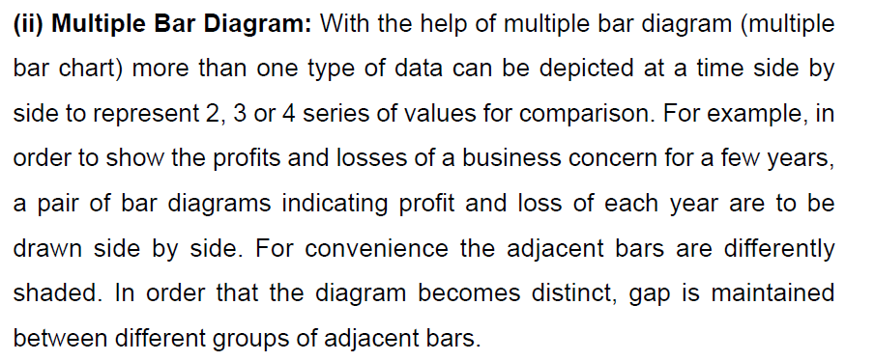
Bar Diagram

Slide 25
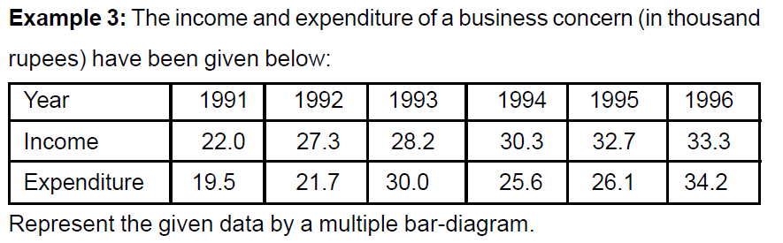
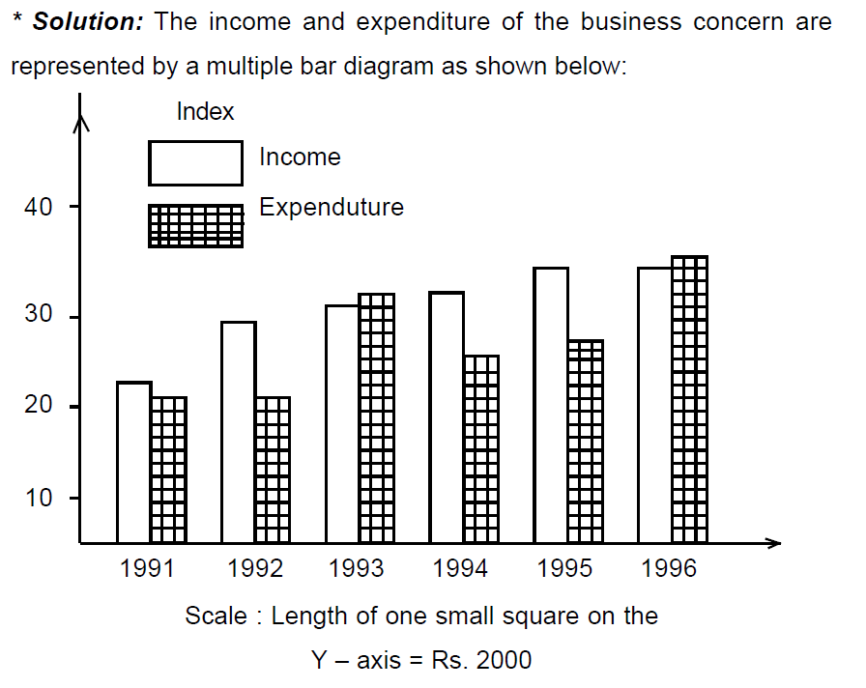
Bar Diagram

Slide 26
Bar Diagram
Year Income Expenditure
1991 22 19.5
1992 27.3 21.7
1993 28.2 30
1994 30.3 25.6
1995 32.7 26.1
1996 33.3 34.2

Slide 27
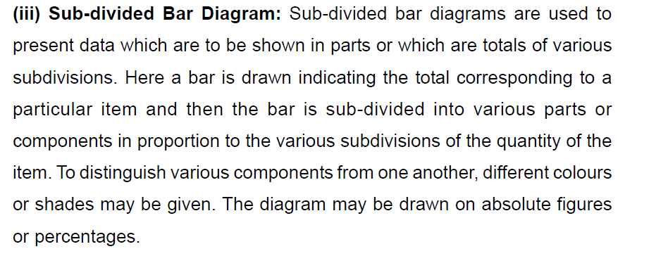
Bar Diagram

Slide 28
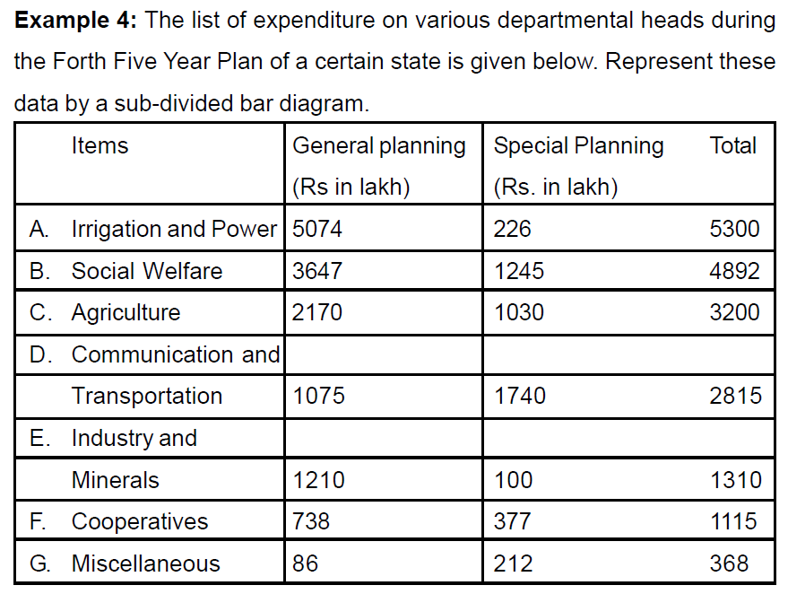
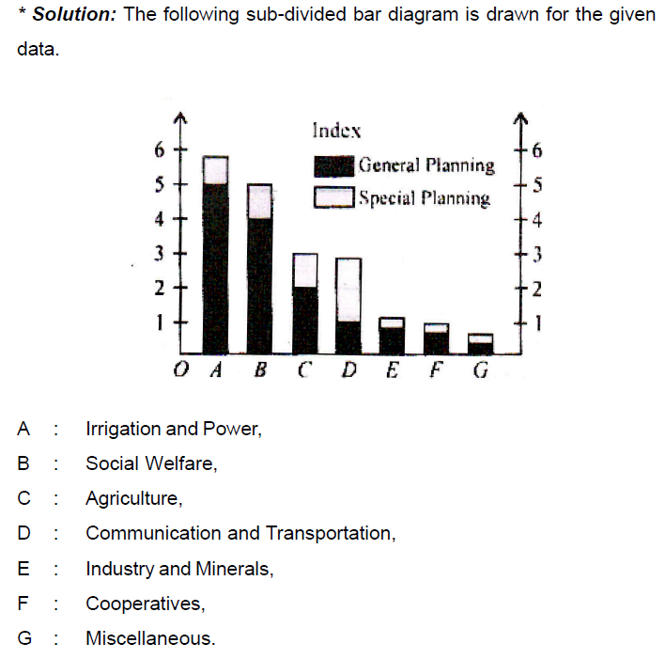
Bar Diagram

Slide 29
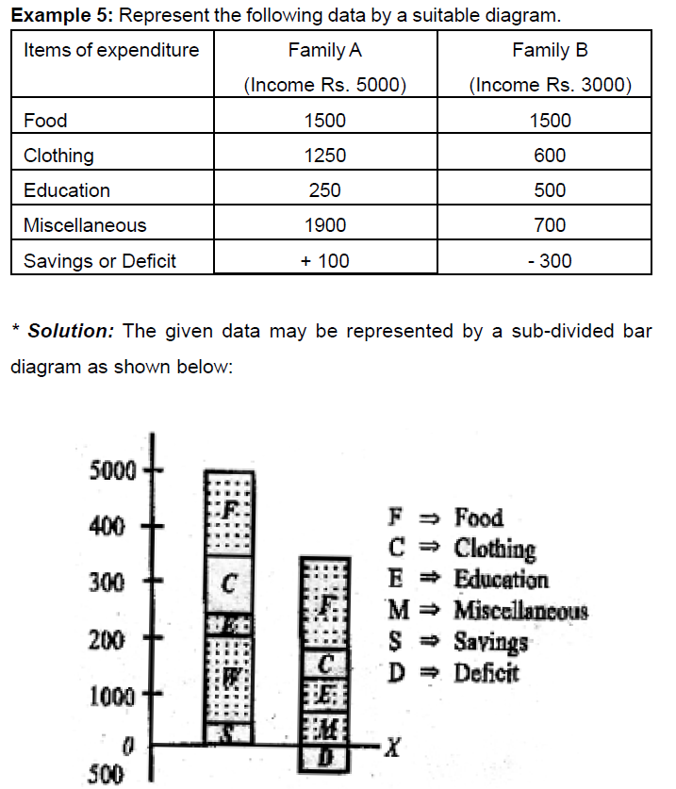
Bar Diagram

Slide 30
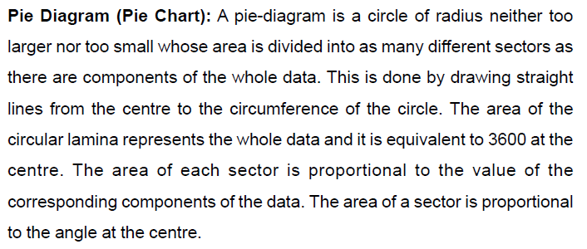
Pie Diagram

Slide 31
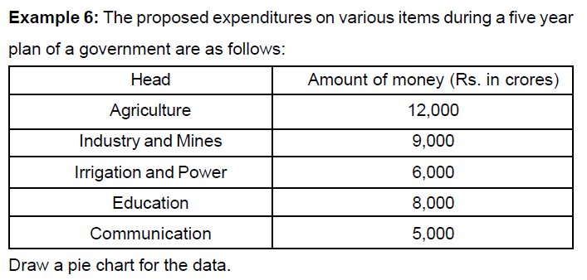
Pie Diagram

Slide 32
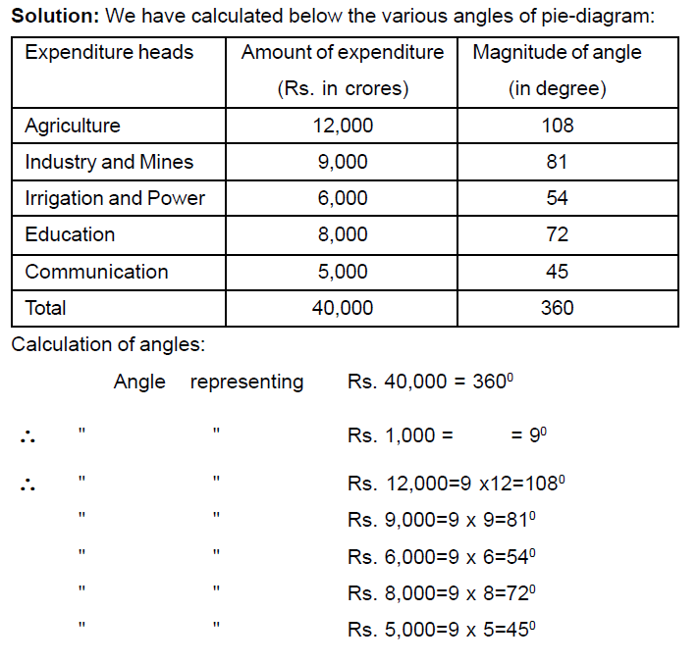
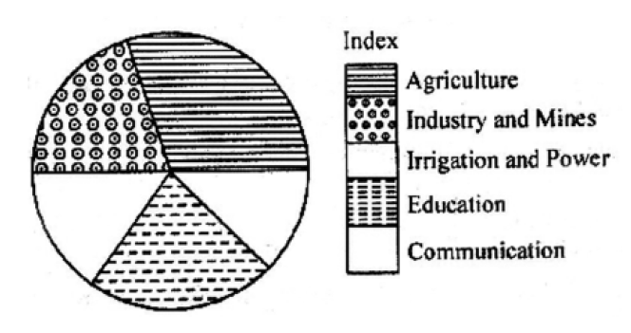
Pie Diagram

Slide 33
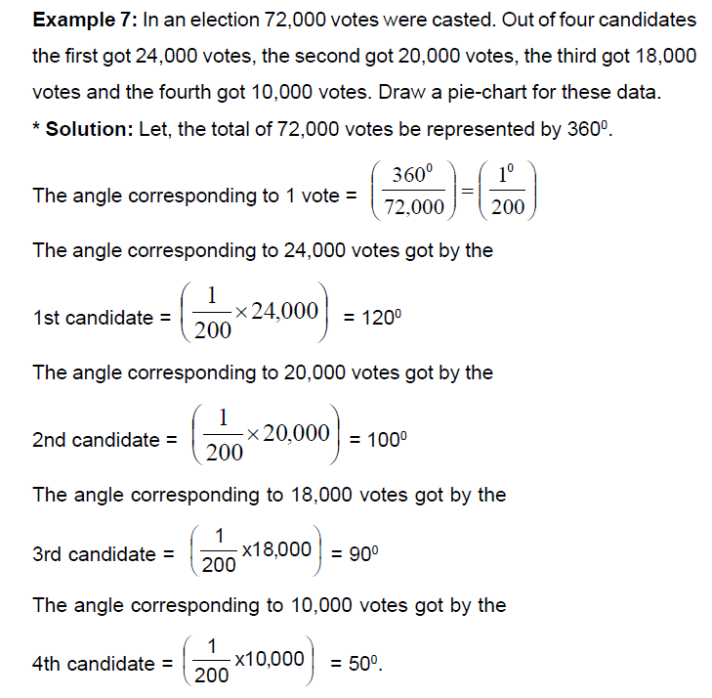
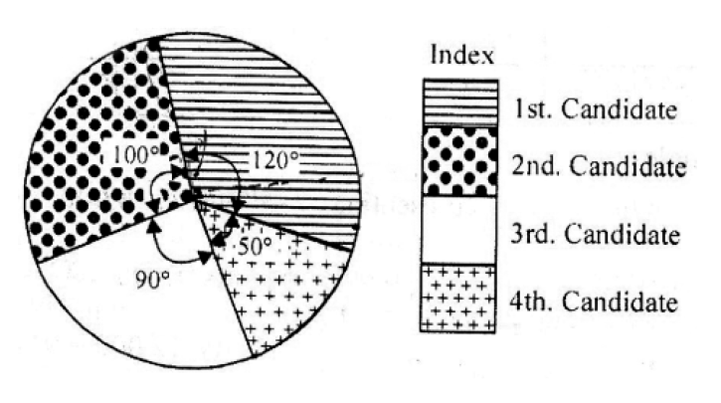
Pie Diagram

Slide 34
Pie Diagram

Slide 35
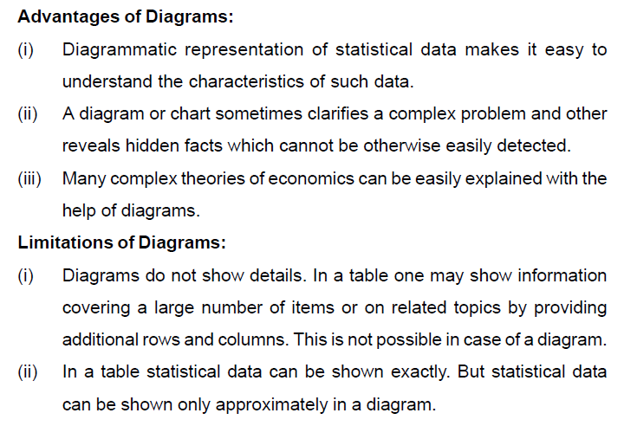

Slide 36
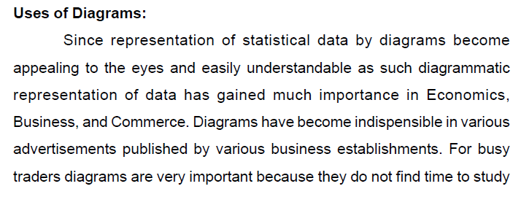


Slide 37
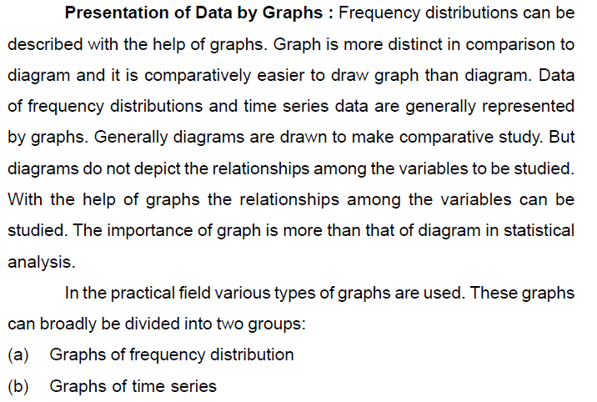

Slide 38
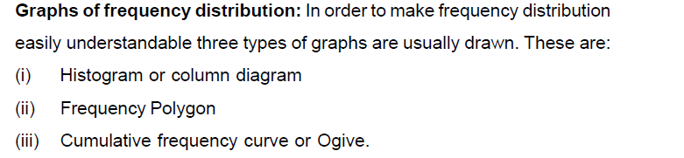

Slide 39
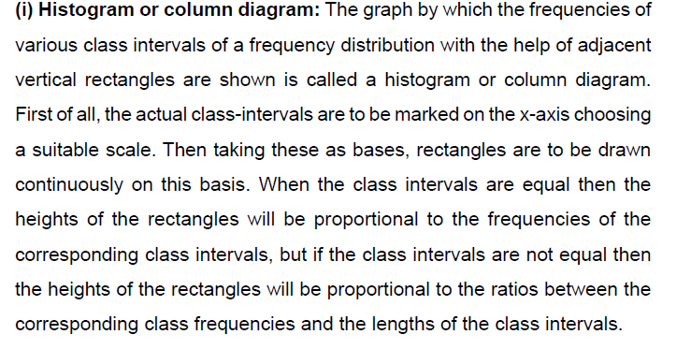

Slide 40
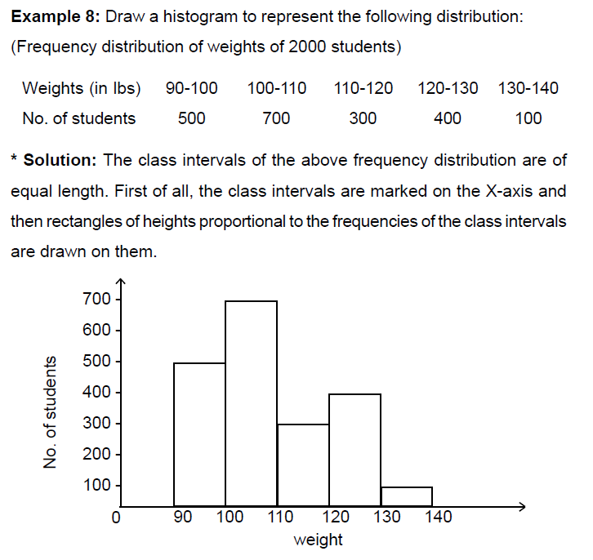

Slide 41
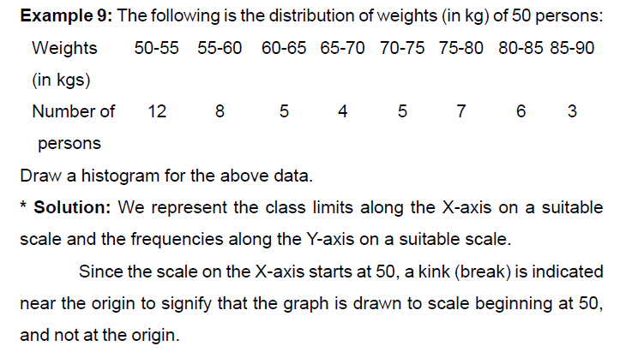
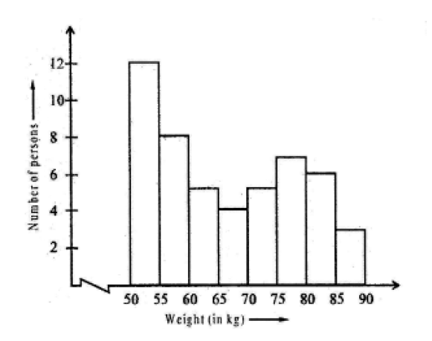

Slide 42
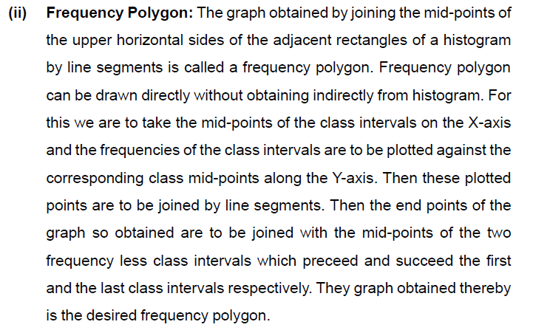

Slide 43

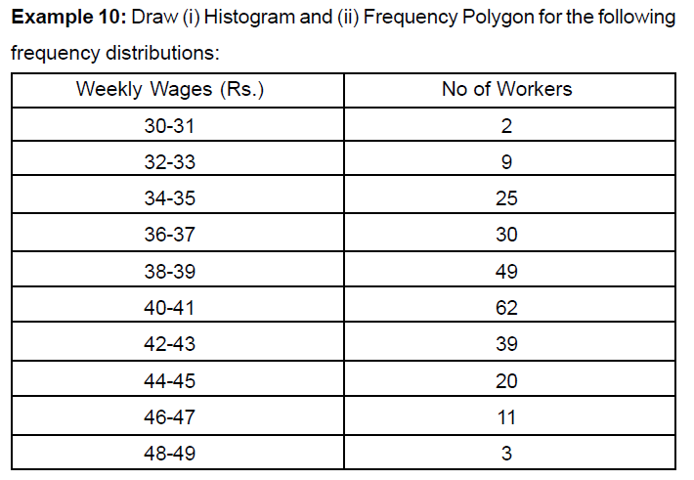

Slide 44
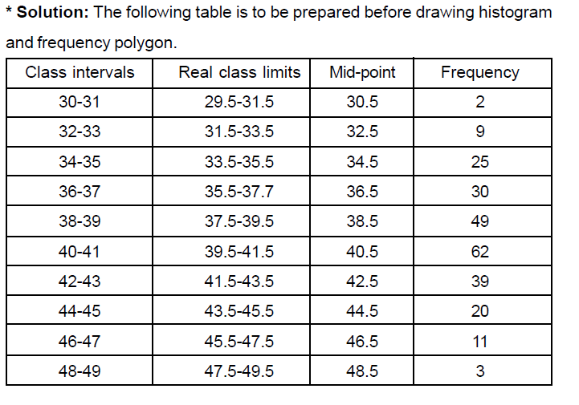

Slide 45
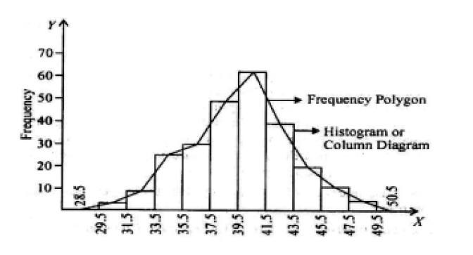
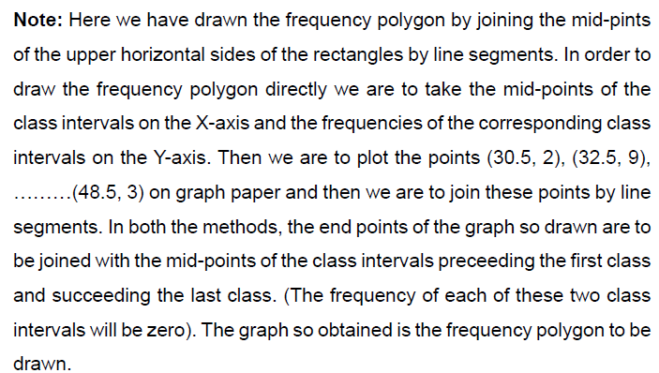

Slide 46
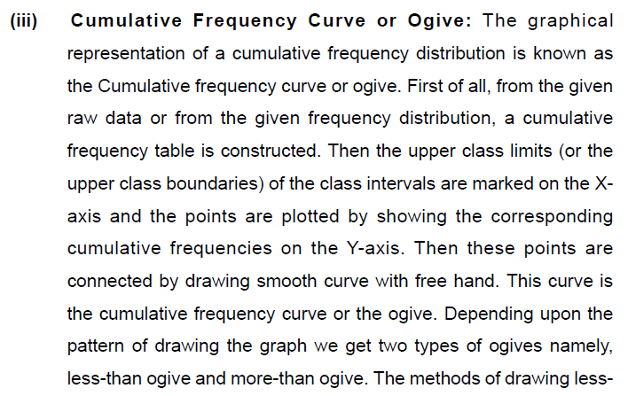


Slide 47
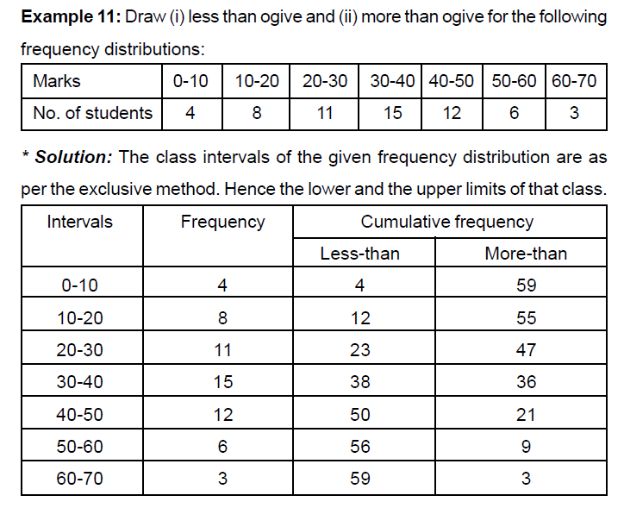

Slide 48
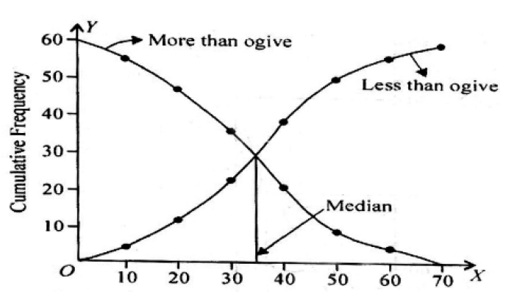

Slide 49
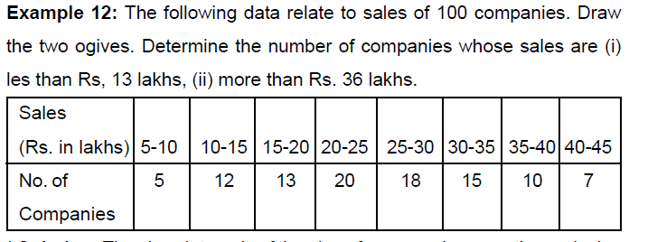

Slide 50
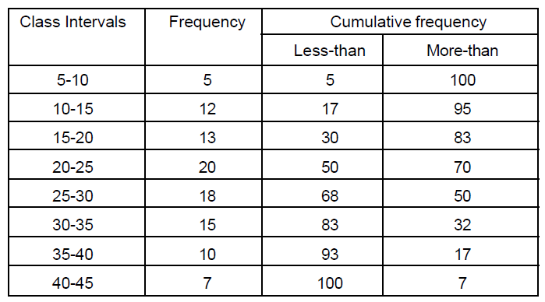

Slide 51



Slide 52

Summary

